Slide 1
Lecture 2
Introduction to Programming:
Data, Arithmetic Statements, Cout, Compiling
Chapters 2, 3

Slide 2
First Program: Console Output
Output of the program is:
Hello World!
cout (Console Out) allows the programmer to display something to the console
#include<iostream>
using namespace std;
int main()
{
cout << "Hello world!" << endl;
return 0;
}
cout is a predefined class meaning a programmer has already taken the time to write code that interfaces with console.
Importantly, we do not need to know how cout works, only how to use it.

Slide 3
First Program: Library and Main
iostream is the library which contains the code for cout
Library: a collection of completed defines, functions, and classes to assist in a program.
#include<iostream>
using namespace std;
int main()
{
cout << "Hello world!" << endl;
return 0;
}
int main() : this is a special function which defines the start of the program. All programs must have one, and only one main function.
The first statement of the main is the first statement executed by the program. (With a lot of caveats and exceptions)

Slide 4
First Program: Namespace
#include<iostream>
using namespace std;
int main()
{
cout << "Hello world!" << endl;
return 0;
}
cout resides in the namespace of std, to use cout we must first use the namespace it resides in.
Namespace: group entities, objects, and classes under a name.
Importance: imagine we include two libraries that both have their own different cout class. When we type cout which one will be used?
If we type using namespace std then the cout residing in the std namespace will be used.

Slide 5
First Program: Compilation
#include<iostream>
using namespace std;
int main()
{
cout << "Hello world!" << endl;
return 0;
}
Unfortunately our CPU does not inherently understand C++; it only understands binary instructions.
Therefore we must compile the code to translate from the high level language to a binary executable

Slide 6
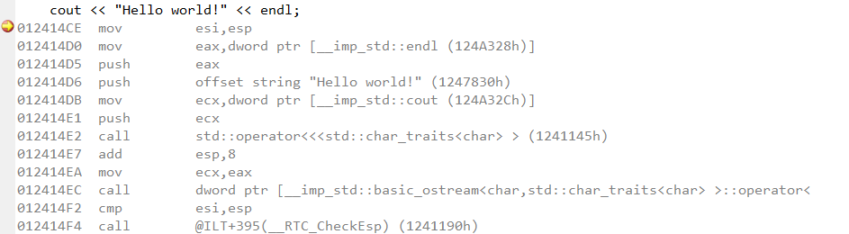
Definitions
Assembly:
A low level programming language using the human readable instructions of the CPU.
Looks Like:
All that for one line of code. Notice in the assembly it performs a call, meaning it will jump
to another point in the assembly and start executing instructions.
This one line of code will execute thousands of lines of instructions!!!!

Slide 7
Definitions
Binary: composed of entirely of:
1’s (represented as a high voltage in computers)
0’s (represented as a low voltage in computers)
CPU processes only binary instructions (Machine Code)
[ op | rs | rt | rd |shamt| funct]
0 1 2 6 0 32 decimal
000000 00001 00010 00110 00000 100000 binary
Example from wikipedia
Instructions are separated into fields each with its own sets of binary encodings giving the field meaning.
Example:
Opcode: 000000 is Add
Opcode: 000001 is Subtract

Slide 8
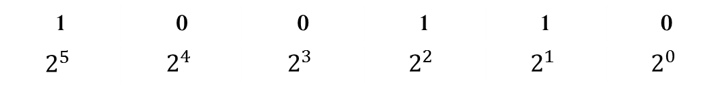
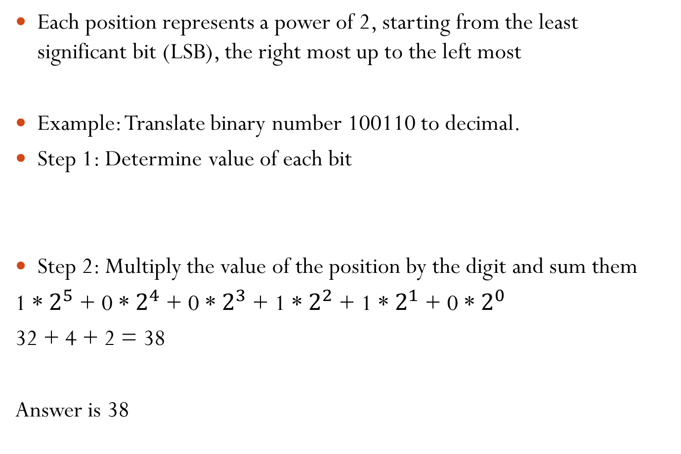
Translating From Binary to Decimal
Each position represents a power of 2, starting from the least significant bit (LSB), the right most up to the left most
Example: Translate binary number 100110 to decimal.
Step 1: Determine value of each bit
Step 2: Multiply the value of the position by the digit and sum them
1 * $2^{5}$ + 0 * $2^{4}$ + 0 * $2^{3}$ + 1 * $2^{2}$ + 1 * $2^{1}$ + 0 * $2^{0}$
32 + 4 + 2 = 38
Answer is 38
1 | 0 | 0 | 1 | 1 | 0
$$2^{5}$$ | $$2^{4}$$ | $$2^{3}$$ | $$2^{2}$$ | $$2^{1}$$ | $$2^{0}$$

Slide 9
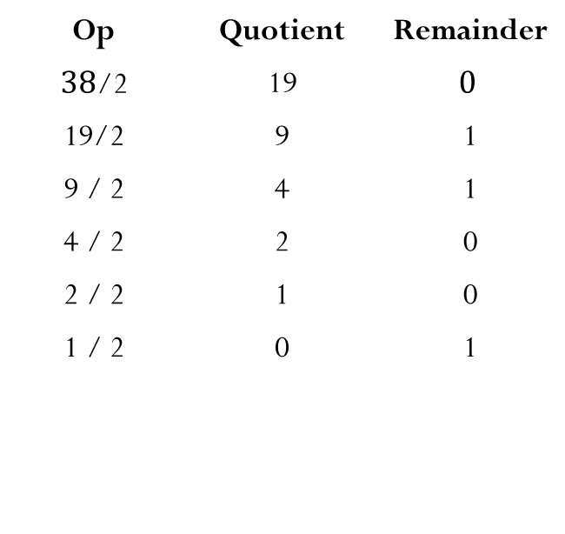
Translating From Decimal to Binary
Repeatedly divide by 2, write the remainder to the right
When the quotient is zero, stop
The most significant bit is the last remainder wrote, and the LSB is the first
Example: Translate decimal number 38 to binary.
Op | Quotient | Remainder
$38$/2 | 19 | $$0$$
19/2 | 9 | 1
9 / 2 | 4 | 1
4 / 2 | 2 | 0
2 / 2 | 1 | 0
1 / 2 | 0 | 1
Answer is:
100110

Slide 10
Back to Compiling
The set of instructions produced targets a specific platform
i.e. compilation for a x86 architecture will not work for a freescale imx 35 (different machine code)
Compiler performs optimizations on source code to increase performance
Doesn’t fix inefficient algorithms
Trade offs between memory usage and processer time
The compiler will flag syntax errors but not logical (semantic)
i.e. missing semicolons, braces, and failing to declare a variable will be caught, however a mistake in the implementation of the algorithm will not.

Slide 11
Procedure translating source code to working program
Editor
Source Code
Compiler
Object
Linker
Executable
The Editor
The interface that allows for the typing of the high level source code
Typically performs syntax highlighting
The object
Encapsulation of your written code into binary instructions. (Still not an executable though)
The Linker
Links source files together into a single executable.
Links or copies libraries into code
Executable is your final program

Slide 12
Definition: Syntax Error
An error in the use of the programming language which results in a failure to compile
Example
int main()
{
int someNum;
someNum = 4
return 0;
}
someNum = 4 is a syntax error since a semicolon is missing. This will result in a failure to compile

Slide 13
Definition: Semantic Error
An error in the program’s logic which causes undesirable behavior at runtime
Example (Calculating the area of a triangle):
int main()
{
int width = 4;
int height = 6;
int area;
area = width * height * width;
}
An incorrect formula is used to calculate the area. This program will run but return incorrect results
In general semantic errors are harder to detect and to correct

Slide 14
Exploring cout
#include<iostream>
using namespace std;
int main()
{
// Acceptable
cout << “Hello world!” << endl;
cout << “1976 Fiat 124 Spider is the best car ever made.” << endl;
cout << 1976 << “ Fiat 124 Spider is the best car ever made.” << endl;
cout << “1976” << “Fiat” << 124 << “Spider is the best car ever made.” << endl;
return 0;
}
endl: creates new line
Rule: When using cout each element must be separated by a << (insertion operator)
Rule: Each statement must end with a semicolon to mark its completion

Slide 15
Definition: Literal
A fixed value in the source code
Is always known at compile time
Example of String Literal
“here is a string literal”
Example of Number Literal
6

Slide 16
Some Bad Examples
#include<iostream>
using namespace std;
int main()
{
// Unacceptable
// mising << between 1976 and “Fiat
cout << 1976 “Fiat 124 Spider is the best car ever made.” << endl;
// Fiat is not in quotes, this makes C++ believe Fiat is a variable
// All text must be contained in quotes
cout << 1976 << Fiat << “ 124 Spider is the best car ever made.” << endl;
// Missing semicolon
cout << “1976” << “Fiat” << 124 << “Spider is the best car ever made.” << endl
return 0;
}

Slide 17
Pop Quiz
What does this display?
#include<iostream>
using namespace std;
int main()
{
cout << “My name is”;
cout << “Luke Pierce”;
}
Answer
My name isLuke Pierce

Slide 18
Types of Data
Data (Binary)
Numerical
Text
Logical
Integer
Character
Boolean
Float
String
Double

Slide 19
Example using data
#include<iostream>
using namespace std;
int main()
{
int year;
year = 1976;
cout << year << “ Fiat ” << 124 << “ Spider is the best car ever made.” << endl;
cout << “year” << “ Fiat ” << 124 << “ Spider is the best car ever made.” << endl;
return 0;
}
Displays:
1976 Fiat 124 Spider is the best car ever made.
year Fiat 124 Spider is the best car ever made.
Notice by not surrounding year in quotes the contents of the variable is printed

Slide 20
Example using data
#include<iostream>
using namespace std;
int main()
{
int year;
year = 1976;
cout << year << “ Fiat ” << 124 << “ Spider is the best car ever made.” << endl;
return 0;
}
Statement: int year;
Declares (creates) an integer variable whose name is year
The name of the variable only gives context to the programmer as to what the variable contains.
The name of the variable never sets the actual contents
Naming your variable one will not automatically set it to one

Slide 21
Example using data
Statement: int year;
All variables must be declared before being used.
We will see why in a few slides
Good Programming Practice (GPP):
Variable names should always give context!!!
Variable Naming Rules
Can only consist of letters, numbers, underscores
May start with a underscore or letter but not a number
GPP
variable names should start with lowercase letter unless a constant
if a name contains multiple words each new word should be capitalized. I.e bondInterest instead of bondinterest

Slide 22
The Assignment Statement
Excluding Program Skeleton:
int year;
year = 1976;
cout << year << “ Fiat ” << 124 << “ Spider is the best car ever made.” << endl;
Sets variable contents. The left operand is always set to the right operand
Left Operand Operator Right Operand
year = 1976;
Assignment Direction
Therefore the left operand must always be a variable and never a constant

Slide 23
Arithmetic Operators (Compute Area)
int area;
area = 5 * 4;
cout << “Area is: “ << area << endl;
Statement: area = 5 * 4;
Arithmetic operators have a high precedence than the assignment and are therefore executed first
Step 1: compute 5 * 4 (20)
Step 2: assign 20 into area
Operators: -, +, /, *, %
Order of operations and parentheses work exactly as a calculator would
Implicit multiplication is illegal!!!!
area = 5(4) will not compile!!!

Slide 24
Modulus Operator (%)
int remainder;
remainder = 15 % 8;
cout << “Remainder of 15 / 8 is: “ << remainder << endl;
Statement: remainder = 15 % 8;
% computes the remainder (not percentage)
Therefore 7 is stored in remainder
Rules:
both the left and right operators must be an integer. You cannot take a remainder of a non-whole number

Slide 25
Single Variable Declaration
int x;
int y;
Multiple Variable Declaration
int x, y;

Slide 26
Single Variable Declaration with initialization
int x = 5;
int y = 2;
Multiple Variable Declaration with initialization
int x = 2, y = 4;

Slide 27
Word of Caution
Consider the following:
int number;
cout << “Number is: “ << number << endl;
What is the displayed?
Cannot be determined. This is an example of an uninitialized variable. The contents is whatever has stored previously in that memory position.
Uninitialized variables can result in peculiar outputs.
The Compiler will typically give a warning.

Slide 28
Chaining Operations and Using Variables
int width, height, length, volume;
width = 20;
height = 10;
length = 15;
volume = width * height * length;
cout << “Volume of the Box: “ << volume << endl;
Just as a calculator you can perform multiple operations prior to storing the result
Operations can be applied to constants as well as variable

Slide 29
Integers and a word of caution
int triArea, height, width;
width = 11;
height = 1;
triArea= width * height * .5;
cout << “Area of the Triangle is: “ << triArea<< endl;
Displays:
Area of the Triangle is: 5
The expected result would be 5.5 however an int (integer) is unable to store a non-whole number
In the case where a non-whole number is stored into an int, the fraction is truncated
For example: if I try to store the number 3.99 into an int, the number stored shall be 3

Slide 30

Floats
float triArea;
int height, width;
width = 11;
height = 1;
triArea= width * height * .5;
cout << “Area of the Triangle is: “ << triArea<< endl;
Displays:
Area of the Triangle is: 5.5
how floats are stored in memory
Floats are capable of storing fractions of a number
Floats have limited precision to typically around 6 decimal places
If you store 3.99 into a float it will be stored as 3.99
If you store 3.999999999999 into a float it will be rounded to 4
This is due to limitations in the instruction size, use double if precision is an issue

Slide 31
If a float can store fractions why use integers at all?
Most Important Reason – Speed
Your CPU has hardware specific for integer operations (IU) and for floating point operations (FPU) in the Arithmetic Logic Unit (ALU)
Integer operations require significantly less clock cycles
Most architectures include more IUs than FPUs
This means more integers can be processed at once vs floats
Bottom Line: Anytime a fraction is not required, use an Integer

Slide 32
Chars
char first, second, third, fourth;
first = ‘L’;
second = ‘u’;
third = ‘k’;
fourth = ‘e’;
cout << first << second << third << fourth << endl;
Displays:
Luke
A char can store a single letter
Keep in mind if you name a char a the variable will not automatically contain an a
To refer to a constant character place a character between a set of apostrophes
Interestingly: a char is nothing more than an integer

Slide 33
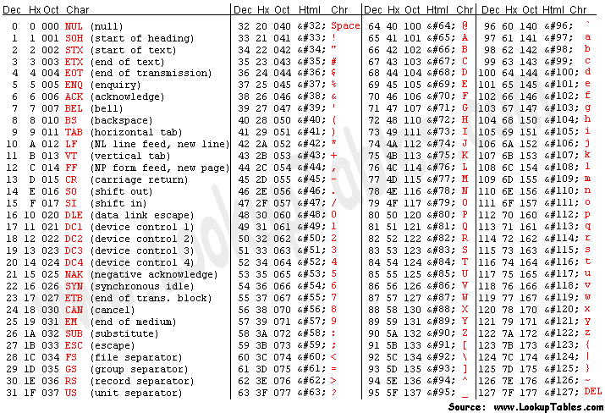
Ascii Chart

Slide 34
Char Pitfalls – MultiChar
char name;
name= ‘Luke’;
cout << name << endl;
As tempting as the above maybe, it will not compile
A char can only take a single character
Thus why it is called char and not chars

Slide 35
Char Pitfalls – Special Characters
char apstrph;
apstrph = '‘’;
cout << apstrph << endl;
char apstrph;
apstrph = ‘\‘’;
cout << apstrph << endl;
What if I want to print a apostrophe?
The left will not compile, the compiler will read the first two apostrophes as a closed set, and the third as an open apostrophe generating a compiler error
For corner cases we must use the escape character (\) shown on the right
The escape character can print many special characters listed on page 85

Slide 36
Strings
string name;
name= “Mr. Rasputin”;
cout << name << endl;
Prints Mr. Rasputin to the console
Allow for a series of characters
NOT a primitive data type
String literal must be surrounding by quotations
Can contain multiple words and lines

Slide 37
Boolean
Simplest datatype: can only be true (not zero) or false (0)
Examples
bool t1, t2, t3, f1, f2;
t1 = 5; // Will be true
t2 = true; // Will be true
t3 = -1; // Will be true
f1 = 0; // Will be false
f2 = false // Will be false
Booleans are represented in memory as a whole byte because modern computers do not have bit addressable memory, rather byte addressable

Slide 38
Data Types
Type | Range (32-bit System) | Description
int | -2147483648 to 2147483647 | All whole numbers both positive and negative
float | +/- 3.4e +/- 38 (~7 digits) | Floating point numbers. Any real number.
double | +/- 1.7e +/- 308 (~15 digits) | Floating point number with twice the precision as float
char | -128 to 127 | Each number corresponds to a symbol. The decoding follows an ascii chart.
bool | 0 to 1 | Can only take the value true or false

Slide 39
C++ Lunacy
float answer;
answer = 5 / 2;
cout << answer << endl;
What will the answer be?
2.0 Huh?
The above is an example of quirk in C++ programming called integer division
When dividing, if both the left and right operands are integers then the result will always be an integer
Essentially the computer divides using the UI
answer = 5 / 2.0; would fix the issue

Slide 40
Whitespace
For the most part C++ is whitespace independent
float answer;
answer = 5 / 2;
answer = 5 / 2 ;
answer = 5 /
2;
answer = 5/2; answer = 5/2;
All of the above is syntax correct, though only the first is acceptable for GPP

Slide 41
Whitespace Cont.
Newlines in strings cannot be achieved by the following:
cout << “This
will not produce a new line”;
Displays:
Thiswill not produce a new line
Either endl or \n must be used
Same applies to tabs
Does not apply to spaces since they are a normal character

Slide 42
Comments
Comments don’t execute. Use them to document your code. To make it easier for other people to read.
// this is a single line comment
// another single line comment
/* this
is a
block comment
*/
Block comments are useful for commenting out sections of code for debugging.

Slide 43
When to use Comments
Personal Preference
If the functionality of a piece of code is not immediately obvious add a comment
Generally good things to comment: functions, loops, new stages in algorithm
For GPP you will be required to have comments on every piece of source code that you submit

